Slide 1
You can teach an old PROC new tricks
Paul Frost
Notes:
Using SAS procedures in novel ways or extending functionality with options and ODS

Slide 2
Title: You can teach an old PROC new tricks! Does PROC XXXX really do that?
Abstract: SAS has a myriad of procedures and we all have a few favourites that we return to again and again. For data summaries and checking we use FREQ, UNIVARIATE, MEANS and SUMMARY. All of these have multiple options and ODS tables which allow a degree of flexibility which isn't always recognised. Using UNIVARIATE to display extreme observations is great but how about putting all those into a dataset with identifiers so the information is available for further processing or distribution? Sometimes choosing a procedure may be influenced by available options such as the use of multi-label formats. The number of procedures capable of using these methods has expanded over the last few years; are you up to date with that? Finally, there are some procedures, PLAN for instance, which can be used in very different ways with just a little imagination. You really can teach an old PROC new tricks!

Slide 3
Agenda
PROC PLAN
Lets mock-up some test data
PROC UNIVARIATE
Data exploration
PROC FORMAT
Categorisation
PROC REPORT
Reporting
Collect
Explore
Categorise
Report
Notes:
This is what we are going to look at today. Firstly, PROC PLAN, which may not be that familiar to many of you.
Next UNIVARIATE which I suspect most of you will use.
Thirdly PROC FORMAT but looking at multilabel formats which adds some interesting featyres.
Finally REPORT, just to end the flow from data collection or creation to exploration and categorisation to reporting

Slide 4
The inspiration…
GEM Mock Shell | Return to TOC |  | Draft
Table 1 Summary of Subject Demographics
(Full Analysis Set)
Variable | Category | Active Treatment N = 53 | Placebo N = 46
Age (Years) | n | 53 (100.0%) | 46 (100.0%)
 | mean | 43.3 | 45.5
 | sd | 15.82 | 14.47
 | min | 20 | 18
 | median | 42 | 47.5
 | max | 66 | 67
Race | n | 53 (100.0%) | 46 (100.0%)
 | Asian | 14 | 13
 | Black | 9 | 9
 | Other | 15 | 8
 | White | 15 | 16
Notes:
This was the inspiration for looking at PLAN.
The requirement to create mock shells in excel.
If we had realistic test data we could program these in SAS and then re-use the programs later.

Slide 5
PROC PLAN
The PLAN procedure designs randomized plans for factorial experiments, especially nested and crossed experiments and randomized block designs. PROC PLAN can also be used for generating lists of permutations and combinations of numbers.
Really a tool for creating different random schema
Can also be used to mock-up test data
Factors are controlled and treatments are random
Only deals with integers and strings
Notes:
PLAN – designed for random schema but can be repurposed to create test data

Slide 6
Syntax
proc plan seed = 152169984;
factors subjid = 100 ordered
visit = 10 ordered
position = 1 of 2;
treatments sysbp = 1 of 25
diabp = 1 of 25
pulse = 1 of 25
temp = 1 of 25;
output out = work.preliminary_vs
subjid nvals = (1001 to 1050 1051 to 1100)
visit nvals = (1 to 10)
position cvals = ('Standing' 'Supine')
sysbp nvals = (110 to 158 by 2)
diabp nvals = (60 to 108 by 2)
pulse nvals = (50 to 98 by 2)
temp nvals = (360 to 384 by 1);
run;
Notes:
PLAN syntax

Slide 7
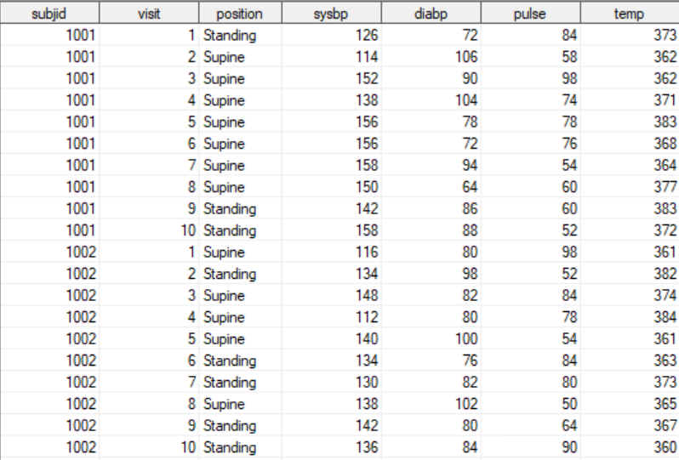
Example PLAN Output
Notes:
Example output
Notice that this data is itemised and for SDTM it needs to be normalised.
We use a post-processing program to do this just using arrsys.
This also allows us to convert the temperature to a more realistic value by dividing by 10.

Slide 8
PROC UNIVARIATE
UNIVARIATE has many uses from summaries to data cleaning
We are going to look at data cleaning
Identify outlying values
The default output – useful but limited
ODS output object
Notes:
I use UNIVARIATE every day for looking at data and creting summary statistics.

Slide 9
Example Univariate Output
Extreme Observations
Lowest |  |  |  |  |  |  | Highest
Value | visit | usubjid | lbtestcd | lborres | lborresu | Obs | Value | visit | usubjid | lbtestcd | lborres | lborresu | Obs
99.44 | 14 | PhUSE2020-1062 | ALT | 110 | IU/L | 4934 | 1354.02 | 10 | PhUSE2020-1021 | ALT | 136 | IU/L | 1638
99.44 | 7 | PhUSE2020-1030 | ALT | 110 | IU/L | 2346 | 1359.74 | 9 | PhUSE2020-1001 | ALT | 136 | IU/L | 34
99.77 | 16 | PhUSE2020-1029 | ALT | 110 | IU/L | 2302 | 1414.75 | 1 | PhUSE2020-1055 | ALT | 142 | IU/L | 4322
99.77 | 19 | PhUSE2020-1019 | ALT | 110 | IU/L | 1514 | 1415.70 | 17 | PhUSE2020-1023 | ALT | 142 | IU/L | 1826
99.77 | 1 | PhUSE2020-1015 | ALT | 110 | IU/L | 1122 | 1554.37 | 8 | PhUSE2020-1052 | ALT | 156 | IU/L | 4110
Notes:
This is the default output in HTMl; this is quite useful but we can finesse this a little

Slide 10
Just Selecting ExtremeObs
Output Added:
Name: ExtremeObs
Label: Extreme Observations
Template: base.univariate.ExtObs
Path: Univariate.LBSTRESN.ExtremeObs
ods output ExtremeObs = work.out;
proc univariate data = sdtm.lb;
var lbstresn;
id usubjid lbdy;
run;
ods output close;
Notes:
Using ODS we can select just the table we want and create a dataset.
If you are unfamiliar with the ODS tables generated by a procedure then use ODS TRACE ON / ODS TRACE OFF.
Put these statements around the PROC and this information about the ODS tables will be written to the SAS Log.

Slide 11
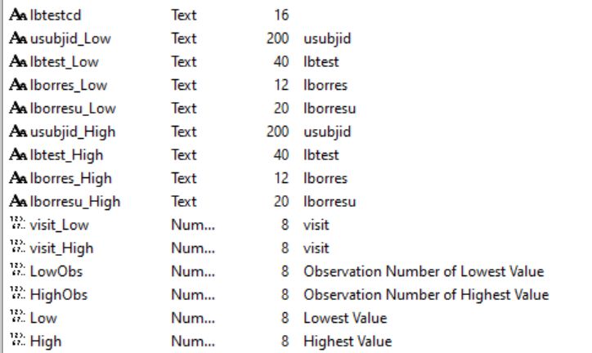
Options and Ideas
Massage output
By default high and low are in the same dataset
Keep in separate datasets, rename, and SET back together
NEXTROBS = nn
request a different number of extreme observations
Keep increasing until the output dataset covers all the outliers
Notes:
One thing we might want to consider is massaging the default data.
The extreme observations dataset has low and high observations in the same dataset.
The ODS table mirrors the HTML output.
We might want to take two copies and just keep the low values in one and the high values in the other.
NEXTROBS specifies how many extreme observations to include – the default is 5.

Slide 12
Syntax
ods output ExtremeObs = work.low (keep = **** rename = (****));
ExtremeObs = work.high (keep = **** rename = (****));
proc univariate data = phuse.lb nextrobs = 15;
var lbstresn;
id usubjid visit lbtest;
class lbtestcd;
run;
ods output close;
data lb_out;
set low high;
by lbtestcd;
label lbvalue = 'Outlying LB value’
obs = 'Observation number of outlier';
run;
Notes:
A template of the univariate syntax and joining the data back together

Slide 13
Output Data
Notes:
And this is what it looks like…

Slide 14
Multilabel Formats
Categorise
Create overlapping ranges for categories
Age
Add zero filled rows
preloadfmt
Add Totals
No need to create duplicate records in your data to summarise totals
proc format fmtlib;
value $trt (multilabel)
'Active’ = 'IP'
'Placebo’ = 'Placebo'
low - high = 'Total';
value age (multilabel notsorted)
0 -< 18 = '<18'
18 -< 20 = 'Teens'
20 -< 30 = 'Twenties'
30 -< 40 = 'Thirties'
0 -< 40 = 'Below 40'
40 - high = 'Above 40'
low - high = 'All';
value eligible
low - 10 = 'Crimson'
11 - < 20 = 'NavajoWhite'
20 - high = 'MediumSeaGreen';
run;
Notes:
PROC FORMAT
Most people will have used user defined formats. These were introduced in SAS 8.2 which was back in 2002?
Not everyone has used multilabel formats.
These allow overlapping ranges.
Multilablel formats can be referenced in a number of SAS procedures:
MEANS
TABULATE
SUMMARY
REPORT
When MLF was introduced REPORT wasn’t supported.

Slide 15
Multilabel formats and Proc Report
proc report data = phuse.dm nowd missing
column trt01a age age = agemean;
define trt01a / group mlf format = $trt.;
define age / order order = data
across format = age. mlf preloadfmt
"# Patients in each Age Category"
style = [background = eligible.];
define agemean / analysis mean f = 4.1 "Average Age";
run;
AGE uses an alias so the same variable can be used twice in different ways.
MLF specifies that the multilabel format is used
PRELOADFMT include all levels of the format even if they don’t exist in the data
Using a format with colour names allows dynamic, data driven, colour coding
Notes:
We could use any of the procedures as an example but I have used REPORT
There a are few things going on here which may be new:
Alias
MLF
Preloadfmt
Colouring cells based on values

Slide 16
PROC REPORT Output
 | # Patients in each Age Category
TRT01A | <18 | Teens | Twenties | Thirties | Below 40 | Above 40 | All | Average Age
IP | 0 | 0 | 14 | 11 | 25 | 28 | 53 | 43.3
Placebo | 0 | 2 | 6 | 8 | 16 | 30 | 46 | 45.5
Total | 0 | 2 | 20 | 19 | 41 | 58 | 99 | 44.3
Crimson denotes ineligible subgroup – too few patients [less than 10]
NavajoWhite denotes tentative subgroup [10 – 19]
Green denotes eligible for subgroup analysis [20 and above]
Notes:
And this is our final output with colour coded cells and footnotes
Note we have zero filled rows
Also see how the age categories overlap!

Slide 17
Conclusions
SAS has multiple ways of doing things and some procedures can be used to do things they weren’t originally designed for.
There are a lot of options available with many procedures and it might be useful to investigate some of those!
Available options evolve with new versions of SAS; it’s always worth checking the latest documentation.
For questions or comments please contact: paul.frost@GEMProgramming.com

